Slide 1
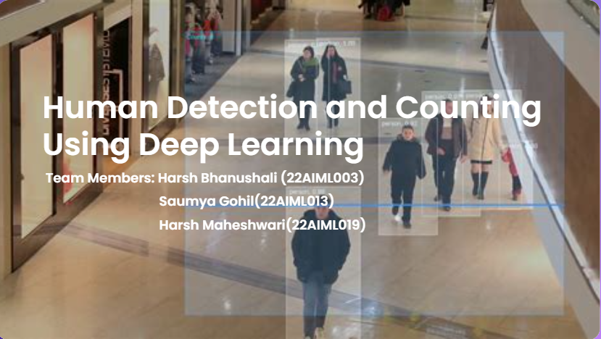

Slide 2
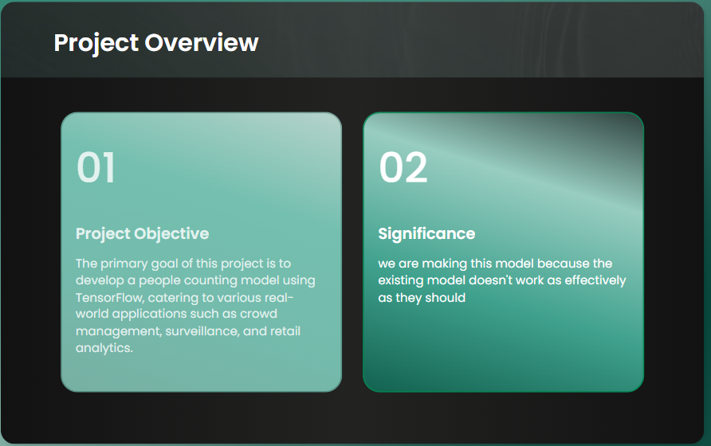

Slide 3
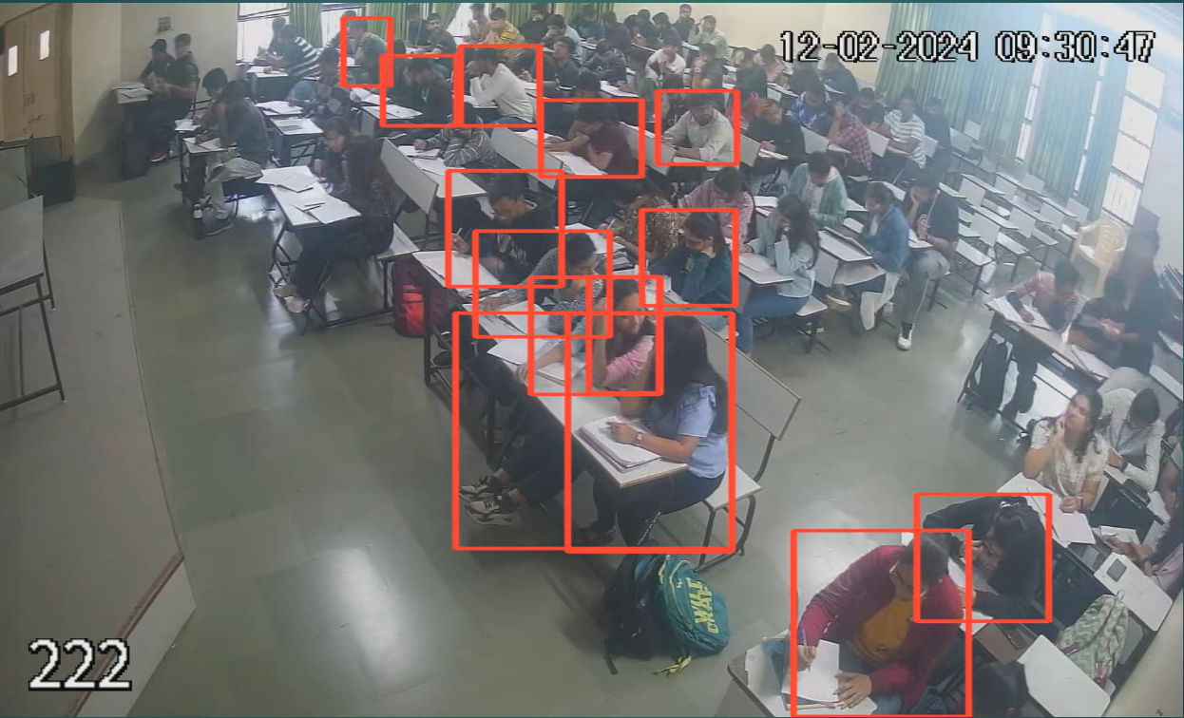
Drawback of yolo

Slide 4


Slide 5
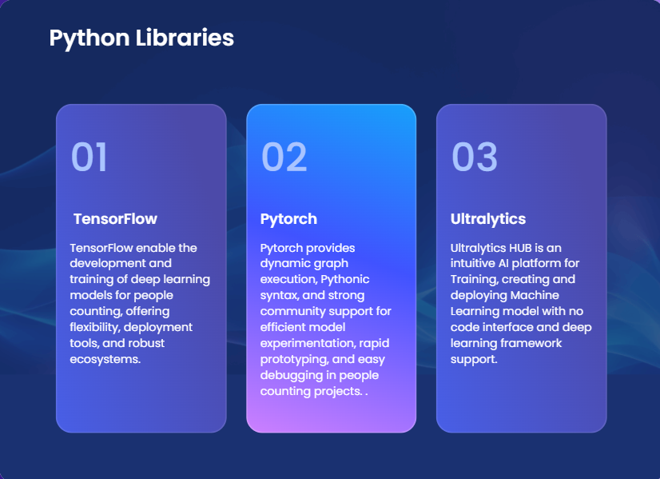

Slide 6
Custom Model
Initially, we aimed to develop a custom model specifically for the human detection project.
This involved experimenting with different custom models using various types of convolutional layers.
Despite our efforts and the variety of models we tested, we were unable to achieve satisfactory results. Consequently, we shifted our approach and decided to fine-tune the YOLO model instead. This pre-trained model allowed us to leverage its existing capabilities for human detection and optimize it further for our specific use case.

Slide 7
Yolo Fine tuning
Fine-tuning a YOLO model using Ultralytics involves adapting a pre-trained YOLO model to a specific task by optimizing its parameters and architecture. Here we used Yolo8x as an existing pre-trained model.
- Pre-Trained Model: Begin with a pre-trained YOLO model available from Ultralytics to leverage existing knowledge.
- Data Preparation: Prepare and annotate your dataset, ensuring it matches the input requirements of the YOLO model.
- Layer Freezing: Optionally, freeze lower layers to retain learned features and focus on fine-tuning higher-level layers.

Slide 8
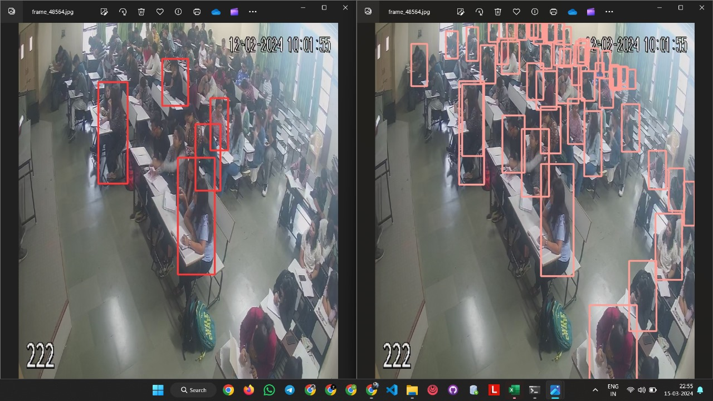
Yolo v8x v/s Our Model

Slide 9
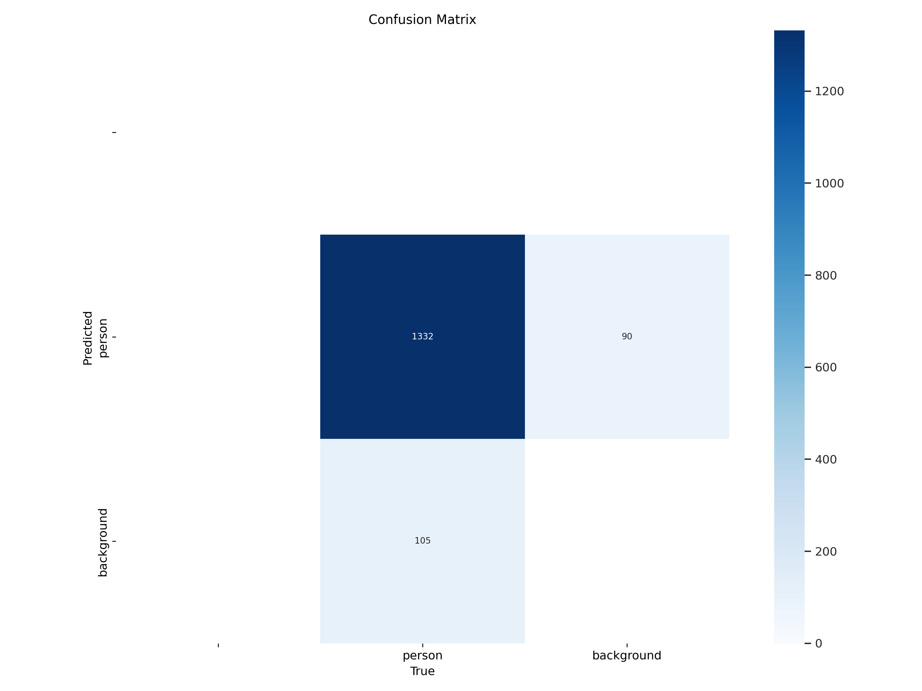

Slide 10
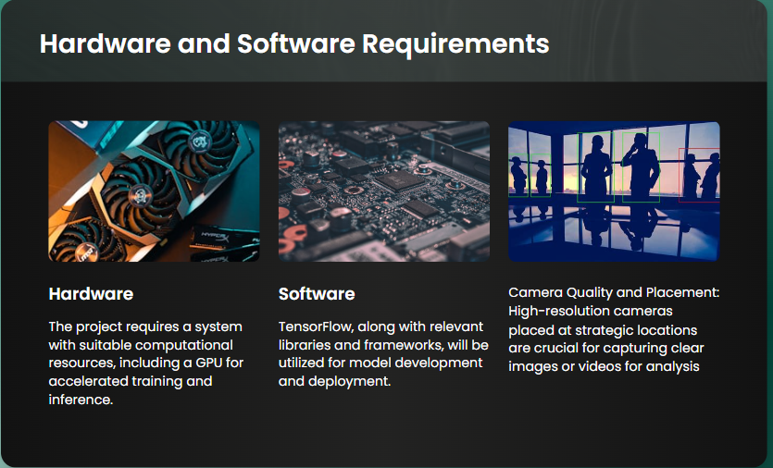

Slide 11
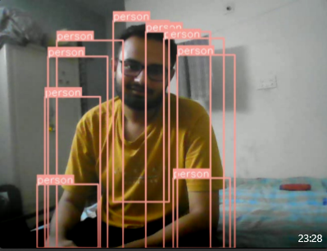
Nothing is Perfect
When a model is fine-tuned for a specific scenario and does not generalize well to other scenarios, it can lead to limited performance outside its original training context.
Specific Scenario Optimization: The model has been fine-tuned to excel in a particular environment or context, focusing on a single type of pattern.
Here , In our case, a Classroom
Data Bias: Fine-tuning with a narrow dataset can lead to biases in the model, limiting its ability to handle diverse data.

Slide 12
References:
https://arxiv.org/abs/1506.02640
https://arxiv.org/abs/1506.01497
https://medium.com/@ringlayer/convolutional-neural-network-for-object-recognition-and-detection-126a22af8975
https://www.researchgate.net/publication/323801313_Fine-Tuning_YOLO_to_Perform_a_Real-Time_Visual_Multi-object_Detection_Task_for_an_Autonomous_Underwater_Vehicle
https://www.youtube.com/watch?v=WgPbbWmnXJ8
https://arxiv.org/abs/1512.02325
https://arxiv.org/abs/2012.04164

Slide 13


